Slide 1


Start with PowerBI
Learn & Practice
“From Rookie to Rock”
Quick Guide of
CALCULATE
Row
Context
Context of transition
Filter
Context
Substitution
role
Patou Tips #48

Slide 2

CALCULATE
Summary
If you only need to know and understand one DAX formula, make it this one. CALCULATE is the most powerful function in the DAX language. Here a Quick Guide to explore step by step how this function works.
Part 1 - Substitution role, Calculation with “FILTER”
Part 2 - Context transition, Calculation with ALL, ALLEXCEPT, ALLSELECTED
Part 3 - Context transition & Iteration
Part 4 - Rules Summary
Part 5 - Useful Patterns
Start with PowerBI
“From Rookie to Rock”
Patou Tips #48 – Quick Guide of Calculate

Slide 3
Quick Guide of CALCULATE
Substitution role,
Calculation with “FILTER”
Part 1
Start with PowerBI
“From Rookie to Rock”
Patou Tips #48

Slide 4
About CALCULATE (1/3)
Syntax and definition
If you only need to know and understand one DAX formula, make it this one. CALCULATE is the most powerful function in the DAX language. In this new series we will explore step by step how this function works.
Syntax
CALCULATE ( Expression, Filter 1, Filter 2, …, Filter n)
Definition
Evaluates an expression based on a context modified by filters and returns a single value of any type (Scalar).
Note 1: The project's modeling structure must be taken into account.
Note 2: The number of filters applied can be very large.
Start with PowerBI
“From Rookie to Rock”
Patou Tips #48 – Quick Guide of Calculate

Slide 5

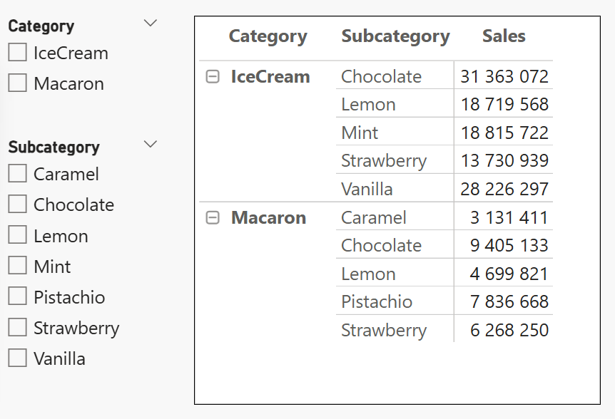

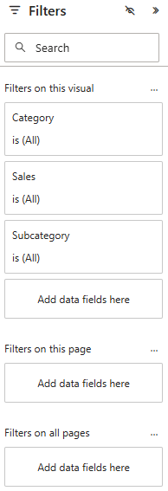

About CALCULATE (2/3)
Row and filter context notion
The CALCULATE function is like a radar that takes into account the elements (filters) available in its environment…
The value
is the result of
Row context
(IceCream and Chocolate)
Filter context
Slicer or Filters pane
Start with PowerBI
“From Rookie to Rock”
Patou Tips #48 – Quick Guide of Calculate

Slide 6
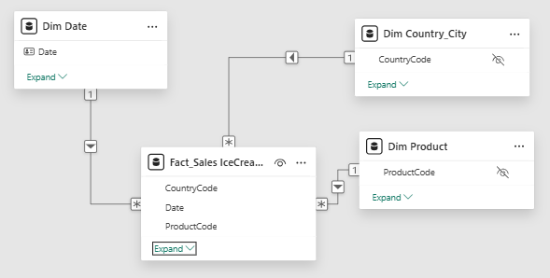
About CALCULATE (2/3)
Structure of the modeling
The CALCULATE function also depends on the project modeling. The "Calculate" function will activate data flows between dimension tables and fact tables.
Start with PowerBI
“From Rookie to Rock”
Patou Tips #48 – Quick Guide of Calculate

Slide 7
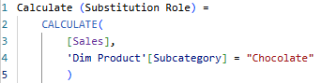
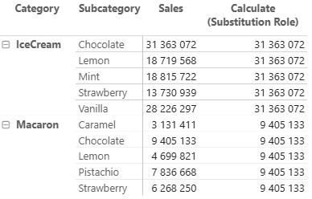
CALCULATE
Substitution role (1/2)
This formula is really interesting, to create a substitute role to better understand the context line.
?
The expected result displays values ​​on all rows, not just the "Chocolate" rows.
Start with PowerBI
“From Rookie to Rock”
Patou Tips #48 – Quick Guide of Calculate

Slide 8
CALCULATE
Substitution role (2/2)
Explanations about the behavior of the CALCULATE function
Chocolate
Chocolate
Chocolate
Chocolate
Chocolate
Chocolate
Chocolate
Chocolate
Chocolate
Chocolate
→ For each row, "Calculate" replaces the value in the "Subcategory" column with the value "Chocolate."
→ For each row, the result depends on the value in the "Category" field (here, Ice Cream or Macaron), and for the "Subcategory" value, "Calculate" replaces the value with the value "Chocolate."
→ This is why the result corresponds to the value of Chocolate in each "Category."
Start with PowerBI
“From Rookie to Rock”
Patou Tips #48 – Quick Guide of Calculate

Slide 9
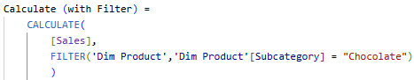
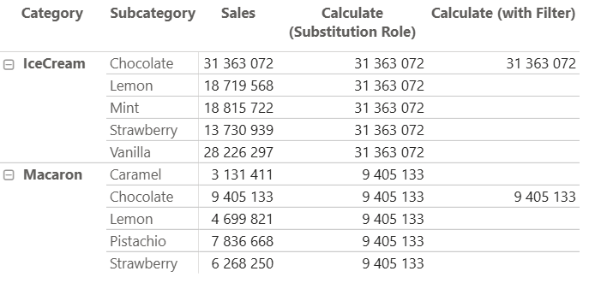
CALCULATE
Calculation with “FILTER”
To create a formula that allows you to filter the previous result only on the "Chocolate" lines, the combination with the "FILTER" function is perfect.
The expected result displays values ​​only in the "Chocolate" rows.
Start with PowerBI
“From Rookie to Rock”
Patou Tips #48 – Quick Guide of Calculate

Slide 10

Quick Guide of CALCULATE
Context transition,
Calculation with ALL, ALLEXCEPT, ALLSELECTED
Part 2
Start with PowerBI
“From Rookie to Rock”
Patou Tips #48

Slide 11
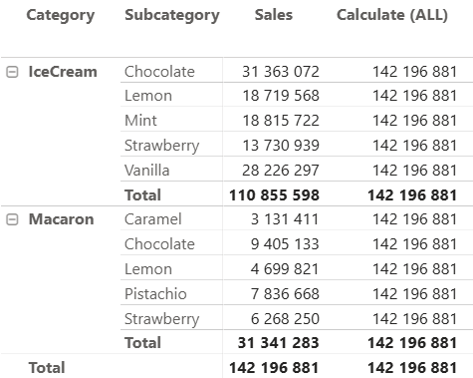
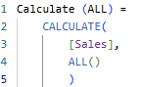
Un argument de filtre remplace les filtres correspondants existants sur la ou les mêmes colonnes, sauf s'il est intégré dans KEEPFILTERS.
L'évaluation de CALCULATE suit les étapes suivantes :
CALCULATE évalue tous les arguments de filtre explicites du contexte d'évaluation d'origine, indépendamment les uns des autres. Cela inclut les contextes de ligne d'origine (le cas échéant) et le contexte de filtre d'origine. Une fois cette évaluation terminée, CALCULATE commence à construire le nouveau contexte de filtre.
CALCULATE effectue une copie du contexte de filtre d'origine pour préparer le nouveau contexte de filtre. Il supprime les contextes de ligne d'origine, car le nouveau contexte d'évaluation n'en contiendra aucun.
CALCULATE effectue la transition de contexte. Il utilise la valeur actuelle des colonnes des contextes de ligne d'origine pour fournir un filtre avec une valeur unique pour toutes les colonnes en cours d'itération dans les contextes de ligne d'origine. Ce filtre peut contenir ou non une ligne individuelle. Il n'est pas garanti que le nouveau contexte de filtre contienne une seule ligne à ce stade. Si aucun contexte de ligne n'est actif, cette étape est ignorée. Une fois tous les filtres implicites créés par la transition de contexte appliqués au nouveau contexte, CALCULATE passe à l'étape suivante.
CALCULE évalue les modificateurs CALCULATE utilisés dans les arguments de filtre : USERELATIONSHIP, CROSSFILTER, ALL, ALLEXCEPT, ALLSELECTED et ALLNOBLANKROW. Cette étape intervient après l'étape 3. Elle est très importante, car elle permet de supprimer les effets de la transition de contexte en utilisant ALL comme argument de filtre. Les modificateurs CALCULATE sont appliqués après la transition de contexte et peuvent donc en modifier les effets.
CALCULE applique les arguments de filtre explicites évalués à l'étape 1 au nouveau contexte de filtre généré après l'étape 4. Ces arguments de filtre sont appliqués au nouveau contexte de filtre une fois la transition de contexte effectuée afin de pouvoir l'écraser, après la suppression du filtre (leur filtre n'est supprimé par aucun modificateur ALL*) et après la mise à jour de l'architecture relationnelle. Cependant, l'évaluation des arguments de filtre s'effectue dans le contexte de filtre d'origine et n'est affectée par aucun autre modificateur ou filtre de la même fonction CALCULATE. Si un argument de filtre est modifié par KEEPFILTERS, le filtre est ajouté au contexte de filtre sans écraser les filtres existants sur la ou les mêmes colonnes.
Le contexte de filtre généré après le point (5) est le nouveau contexte de filtre utilisé par CALCULATE pour l'évaluation de son expression.
CALCULATE
Calculation with ALL (1/2)
ALL remove all the filter specified inside the function. When nothing is specified, ALL remove all the filters.
Only ALL
If nothing is specified, ALL removes all filters. The total "Sales" is finally displayed for all rows.
✏️ Note: ALL et REMOVEFILTERS are the same function.
Start with PowerBI
“From Rookie to Rock”
Patou Tips #48 – Quick Guide of Calculate

Slide 12
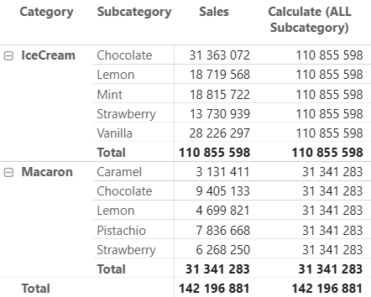
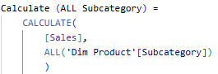
CALCULATE
Context transition with ALL
In this example with an argument inside ALL, we begin to get a better feel for the context transition process.
ALL with argument
Only the "Subcategory" filter is ignored. Therefore, for each "Subcategory," the "Sales" total is displayed for all rows.
The "Category" filter is only considered for each row; this is the context transition.
Start with PowerBI
“From Rookie to Rock”
Patou Tips #48 – Quick Guide of Calculate

Slide 13
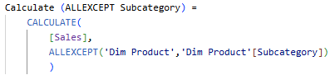
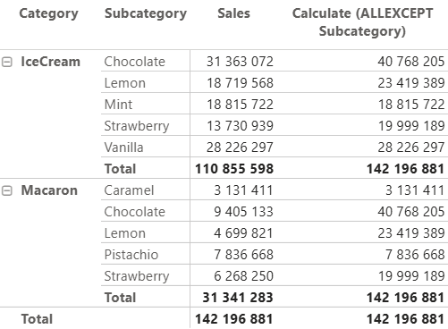
CALCULATE
Context transition with ALLEXCEPT
Context transition is important to understand how the calculations will work. Let's go further with another example.
Only the "Subcategory" filter is taken into account. Therefore, for each "Subcategory" value, the context transition on the sales value will be applied by the same "Subcategory" value.
For the Chocolate "Subcategory", the total corresponds to the sum of all Chocolate values ​​in the list. The process is identical for Lemon.
Start with PowerBI
“From Rookie to Rock”
Patou Tips #48 – Quick Guide of Calculate

Slide 14
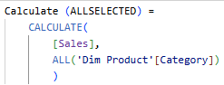
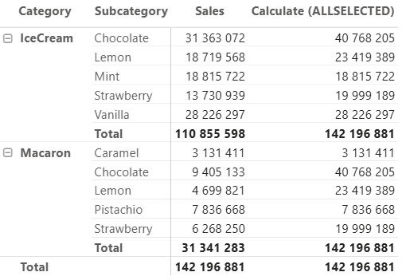
CALCULATE
Context transition with ALLSELECTED
We get the same behavior, context transition with ALL, the explanation is exactly the same as before.
Only the "Subcategory" filter is taken into account. Therefore, for each "Subcategory" value, the context transition on the sales value will be applied by the same "Subcategory" value.
For the Chocolate "Subcategory", the total corresponds to the sum of all Chocolate values ​​in the list. The process is identical for Lemon.
Start with PowerBI
“From Rookie to Rock”
Patou Tips #42
5 Advanced Charts (with Charticulator)

Slide 15
Quick Guide of CALCULATE
Context transition & Iteration
Part 3
Start with PowerBI
“From Rookie to Rock”
Patou Tips #48

Slide 16
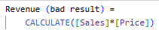
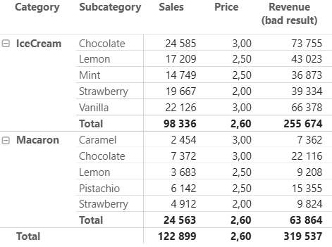


CALCULATE
Context transition & Iteration
When you start to go deeper into CALCULATE, you quickly run into the problem of false results. The problem comes from often of a transition context without reiteration.
x
=
x
=
x
=
= 259362
x
=
x
=
x
=
Each row gives a good result, but the problem comes from the total where the same rule is applied and ultimately gives a bad result.
Start with PowerBI
“From Rookie to Rock”
Patou Tips #48 – Quick Guide of Calculate

Slide 17
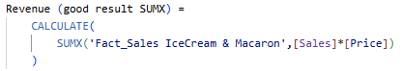
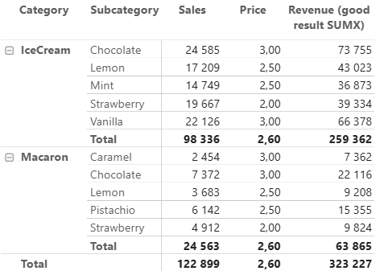
CALCULATE
Context transition & Iteration
Rule → Context Transition is triggered by a Row Context.
x
=
x
=
+
x
=
+
+
= 259362
x
=
+
x
=
=
To get a good result, combine CALCULATE with an iteration function such as SUMX.
Explanation: For each row, CALCULATE with SUMX applies the Row Context ([Sales] x [Price]) to the table (Fact_Sales IceCream & Macaron) and iterates through each row until the final total is reached.
Start with PowerBI
“From Rookie to Rock”
Patou Tips #48 – Quick Guide of Calculate

Slide 18
Quick Guide of CALCULATE
Rules Summary
Part 4
Start with PowerBI
“From Rookie to Rock”
Patou Tips #48

Slide 19
CALCULATE
Evaluation Context
Evaluation Context
The Evaluation Context is composed of:
Row context
Filter context:
Determines the row where the calculation is performed
Row Context
Iteration functions (SUMX, AVERAGEX,...) read each line to create a line context which will trigger the transition context and iteration at each line.
Start with PowerBI
“From Rookie to Rock”
Patou Tips #48 – Quick Guide of Calculate

Slide 20
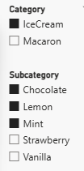
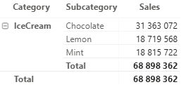
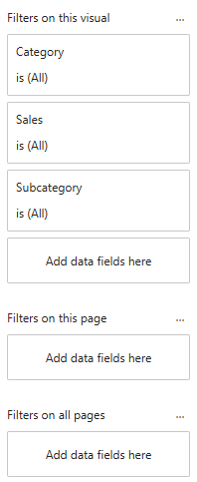
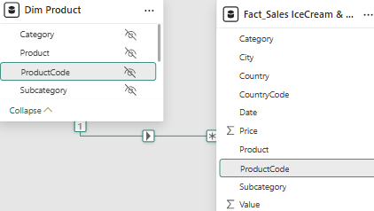
CALCULATE
Evaluation Context
Determines the visible rows and the scope of the calculation
Filter Context
Filtering contexts can be:
Direct: via visual elements, filtering options such as slicers, filter panels, or modeling
Indirect: via filter functions such as ALL (REMOVEFILTER), FILTER, ALLEXCEPT, etc.
Start with PowerBI
“From Rookie to Rock”
Patou Tips #48 – Quick Guide of Calculate

Slide 21
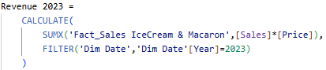
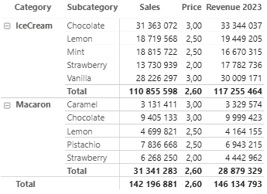
CALCULATE
Context transition
Context Transition
How does it work?
The calculation takes into account the Context Filter for the Evaluation Context, here the year "2023".
Then, still for the Evaluation Context, it takes into account the iteration function applied to each row. This Row Context triggers the Context Transition.
The Context Transition calculates the formula and activates all relationships according to the modeling.
Context transition is the calculation process but also the one that activates modeling relationships.
Start with PowerBI
“From Rookie to Rock”
Patou Tips #48 – Quick Guide of Calculate

Slide 22








CALCULATE
Rules (synthesis)
Evaluation Context
The Evaluation Context (Filter + Row Context) determines the arguments to be taken into account and the calculation scope. The Row Context then will trigger the context transition.
Evaluation Context
Filter Context
Row Context
The Row Context trigger the Context Transition.
When the Transition Context is triggered, the modeling relationship will apply: cardinality, cross-filter direction.
Context Transition
Modelisation
RESULT
Start with PowerBI
“From Rookie to Rock”
Patou Tips #48 – Quick Guide of Calculate

Slide 23
Quick Guide of CALCULATE
Useful Patterns
Part 5
Start with PowerBI
“From Rookie to Rock”
Patou Tips #48

Slide 24
CALCULATE
Useful Patterns
In this new chapter on the DAX "Calculate" function, we will look at some very useful patterns, applying the rules relating to filter and row contexts, and context transition, which we have previously discussed.
Cumulated total (in Time Series)
Cumulated total (with Product dimension)
Average (in Time Series)
Average (with Product dimension)
Patterns with Time Intelligence
Patterns for Min, Max, First, Last values
Use Treatas to connect 2 differents data sources
Start with PowerBI
“From Rookie to Rock”
Patou Tips #48 – Quick Guide of Calculate

Slide 25
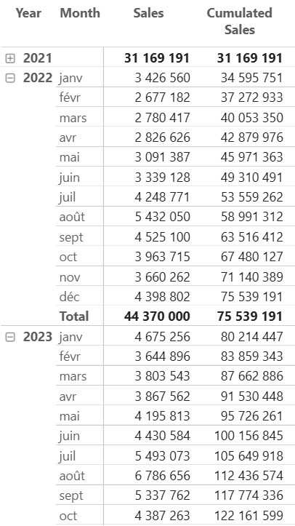
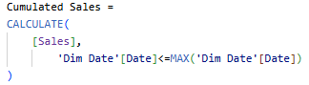
CALCULATE
Cumulated total (in Time Series)
Cumulated Sales
This pattern is interesting to build a cumulated total
In this pattern, the filter is a loop to create a row context. This loop compares the date of the row with the maximum of the date of the selection (the table) for each row. This row context triggers the context transition, so for each row the condition is true, so it performs the cumulative sales for each row.
Start with PowerBI
“From Rookie to Rock”
Patou Tips #48 – Quick Guide of Calculate

Slide 26
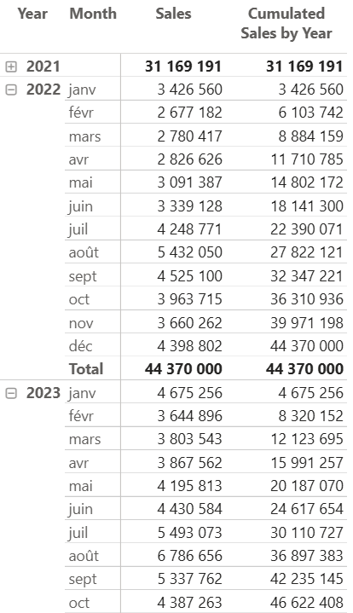
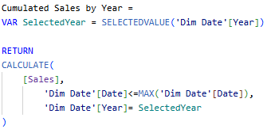
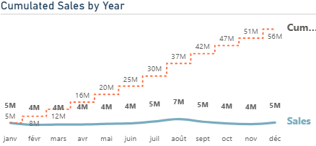
CALCULATE
Cumulated total (in Time Series)
Cumulated Sales by Year
A variation of the previous model, but we have clarified the scope of the calculation (year).
Each year the cumulative sales start again.
Start with PowerBI
“From Rookie to Rock”
Patou Tips #48 – Quick Guide of Calculate

Slide 27
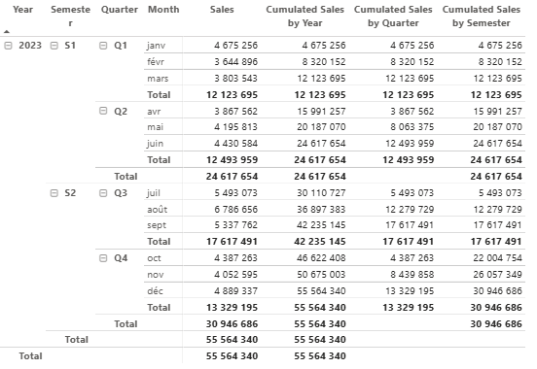
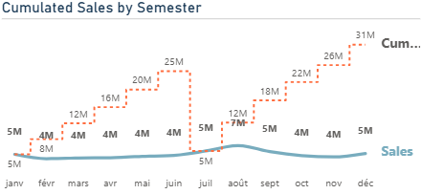
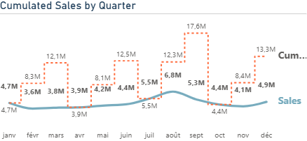
CALCULATE
Cumulated total (in Time Series)
Cumulated Sales variations
→ Many variations can be made, by quarter, by semester...
By year
By semester
By quarter
Start with PowerBI
“From Rookie to Rock”
Patou Tips #48 – Quick Guide of Calculate

Slide 28
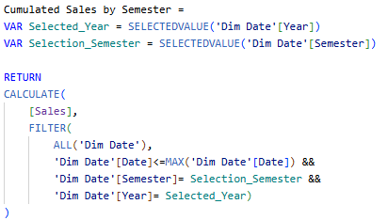
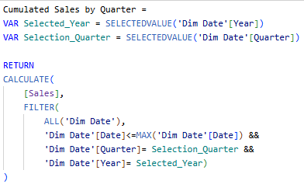
CALCULATE
Cumulated total (in Time Series)
Cumulated Sales variations
By semester
By quarter
Start with PowerBI
“From Rookie to Rock”
Patou Tips #48 – Quick Guide of Calculate

Slide 29
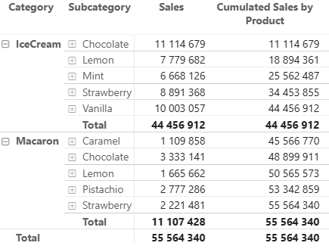
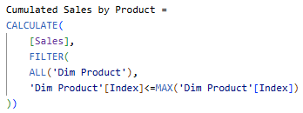
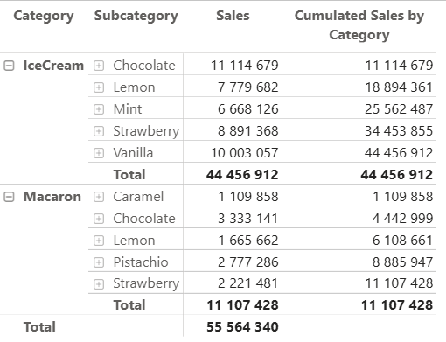
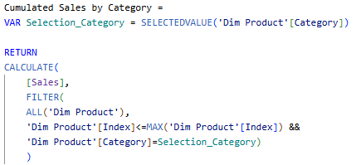
CALCULATE
Cumulated total (with Product dimension)
Cumulated Sales by Product
Here dimension is not a period but p product. It could be made with the dimensions Customer, Supplier, Income Statement, etc.
Cumulated Sales by Category
Start with PowerBI
“From Rookie to Rock”
Patou Tips #48 – Quick Guide of Calculate

Slide 30
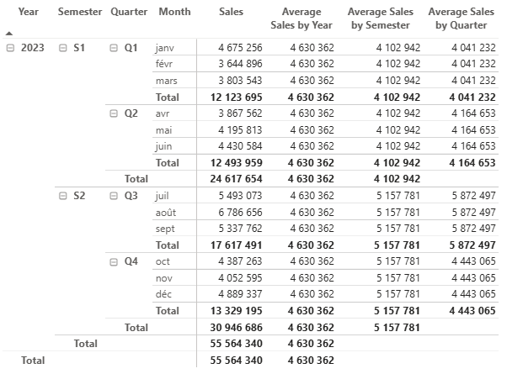
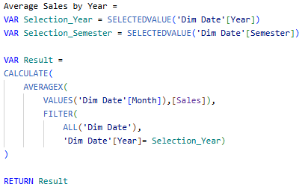
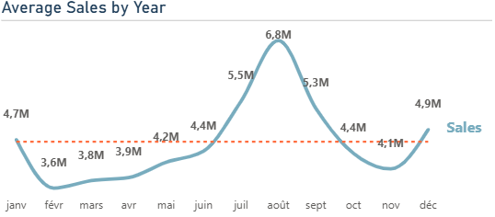
CALCULATE
Average (in Time Series)
Average Sales by Year
A variation of the previous model, but we have clarified the scope of the calculation (year).
AVERAGEX creates favorable conditions for iteration in association with VALUES. Each year, the average sales are recalculated using the FILTER pattern.
Start with PowerBI
“From Rookie to Rock”
Patou Tips #48 – Quick Guide of Calculate

Slide 31
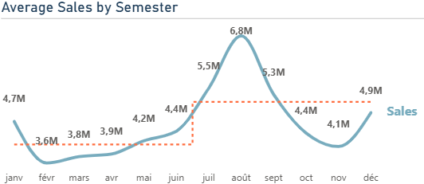
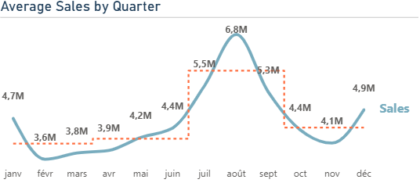
CALCULATE
Average (in Time Series)
Average Sales variations
→ This model is really interesting because many variations can be made, by quarter, by semester...
By year
By semester
By quarter
Start with PowerBI
“From Rookie to Rock”
Patou Tips #48 – Quick Guide of Calculate

Slide 32
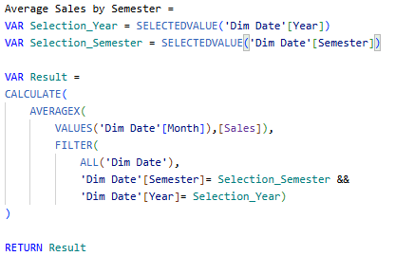
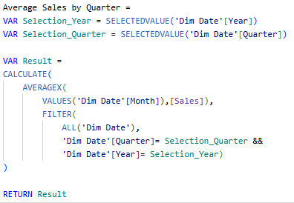
CALCULATE
Average (in Time Series)
Average Sales variations
By semester
By quarter
Start with PowerBI
“From Rookie to Rock”
Patou Tips #48 – Quick Guide of Calculate

Slide 33
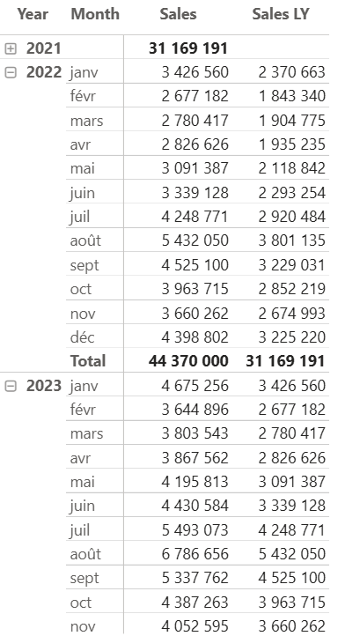
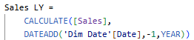
CALCULATE
Time Intelligence
Sales Last Year (LY)
Thanks to the time calculation function, it's the perfect winning combination.
A function such “DATEADD” allow you a lot patterns
Start with PowerBI
“From Rookie to Rock”
Patou Tips #48 – Quick Guide of Calculate

Slide 34
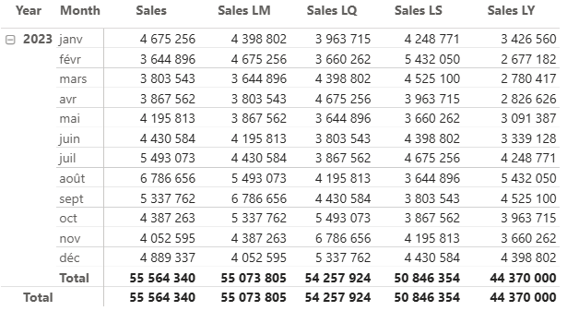
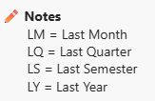



CALCULATE
Time Intelligence
Sales Last Period
Many variations can be made, by week, by month, by quarter, by semester...
For each selected period, the previous value for that period is displayed.
Start with PowerBI
“From Rookie to Rock”
Patou Tips #48 – Quick Guide of Calculate

Slide 35

CALCULATE
Min, Max, First, Last values
Min, Max, First, Last Sales
Often, certain specific values ​​are needed for later uses, for formulas, but also, as in the examples to come, to improve a visualization.
Start with PowerBI
“From Rookie to Rock”
Patou Tips #48 – Quick Guide of Calculate

Slide 36



CALCULATE
Min, Max, First, Last values
Min, Max
The MINX and MAXX functions create
favorable conditions for iteration in with
VALUES. Then, only the desired value
(Min or Max) is displayed.
With ALL, it might be useful to populate the Min or Max value across the entire time series (see next page).
Start with PowerBI
“From Rookie to Rock”
Patou Tips #48 – Quick Guide of Calculate

Slide 37





CALCULATE
Min, Max, First, Last values
Min, Max
Using a coefficient, the ALL calculation allows you to place a line (or an area) above your graph with the Max value or below it with the Min value. This is a useful trick to improve your visualization.
Start with PowerBI
“From Rookie to Rock”
Patou Tips #48 – Quick Guide of Calculate

Slide 38



CALCULATE
Min, Max, First, Last values
Min, Max, First, last
It might be interesting to also add the first or last value of a time series.
Start with PowerBI
“From Rookie to Rock”
Patou Tips #48 – Quick Guide of Calculate

Slide 39




CALCULATE
Use Treatas to connect 2 different data sources
When to use it? To perform a calculation with a variable from another table. Thanks to the Treatas formula it can be more interesting to create a virtual link if one or more references are common.
Example: we have two different data sources (Sales and Costs) and we want to calculate the margin.
2 tables and 2 data sources
No connection between the two data sources
Common references
Start with PowerBI
“From Rookie to Rock”
Patou Tips #48 – Quick Guide of Calculate

Slide 40


CALCULATE
Use Treatas to connect 2 different data sources
Treat the columns of the input table (SALES) as column from other table (COSTS).
Costs with Treatas =
CALCULATE(SUM(Costs[Costs]),
TREATAS(VALUES(Sales[Shop]),Costs[Shop])
)
Note, VALUES search all the unique values from the input table. This pattern is really usefull.
Input table
Other table
Start with PowerBI
“From Rookie to Rock”
Patou Tips #48 – Quick Guide of Calculate

Slide 41

Coming soon, in 2026!
To develop your knowledge, find more explanations, exercises and patterns on CALCULATE.
Over 500 pages to learn and practice: video tutorials and resources

Slide 42






Learn and practice
Find past issues of "Patou Tips" and download resources to practice on GitHub
Patou Tips #5
Create a Customized Chart
(for income statement)
Patou Tips #12 Calculate right evolution for KPI
Patou Tips #6 Create
Customized Icon
Patou Tips #23 Quick Guide Visualization & Storytelling
Patou Tips #7
Create an Age Pyramid Chart
(for Human Ressources)
Resources on GitHub
https://github.com/PatouTips/Patou-Tips

Slide 43

Don’t forget!
This isn't the truth, it's just my truth!
Patou Tips
Follow me
Like me
Share me

